Slide 1
Processing XML with Java
Representation and Management of Data on the Internet

Slide 2
Parsers
What is a parser?
  A program that analyses the grammatical structure of an input, with respect to a given formal grammar
  The parser determines how a sentence can be constructed from the grammar of the language by describing the atomic elements of the input and the relationship among them
How should an XML parser work?

Slide 3
XML-Parsing Standards
We will consider two parsing methods that implement W3C standards for accessing XML
SAX
  event-driven parsing
  “serial access” protocol
DOM
  convert XML into a tree of objects
  “random access” protocol

Slide 4
XML Examples

Slide 5
world.xml
<?xml version="1.0"?>
<!DOCTYPE countries SYSTEM "world.dtd">
<countries>
<country continent="&as;">
<name>Israel</name>
<population year="2001">6,199,008</population>
<city capital="yes"><name>Jerulsalem</name></city>
<city><name>Ashdod</name></city>
</country>
<country continent="&eu;">
<name>France</name>
<population year="2004">60,424,213</population>
</country>
</countries>

Slide 6
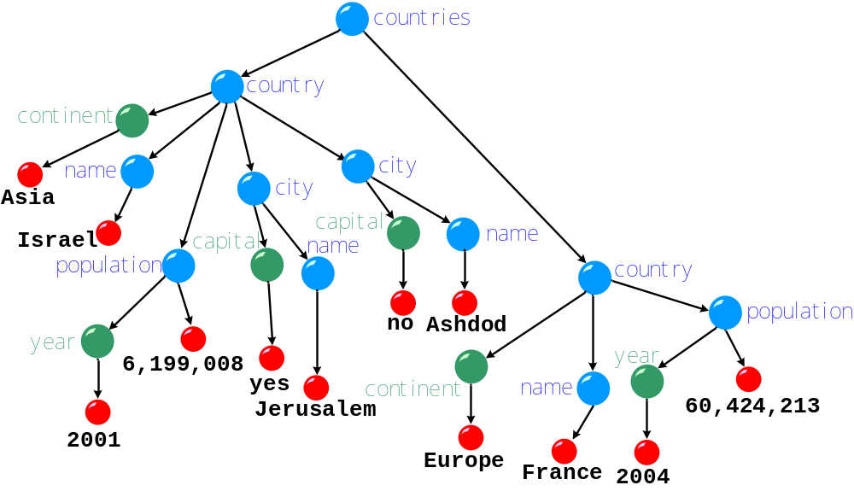
XML Tree Model

Slide 7
world.dtd
<!ELEMENT countries (country*)>
<!ELEMENT country (name,population?,city*)>
<!ATTLIST country continent CDATA #REQUIRED>
<!ELEMENT name (#PCDATA)>
<!ELEMENT city (name)>
<!ATTLIST city capital (yes|no) "no">
<!ELEMENT population (#PCDATA)>
<!ATTLIST population year CDATA #IMPLIED>
<!ENTITY eu "Europe">
<!ENTITY as "Asia">
<!ENTITY af "Africa">
<!ENTITY am "America">
<!ENTITY au "Australia">

Slide 8
sales.xml
<?xml version="1.0"?>
<forsale date="12/2/03"
xmlns:xhtml="http://www.w3.org/1999/xhtml">
<book>
<title> <xhtml:em>DBI:</xhtml:em>
<![CDATA[Where I Learned <xhtml>.]]>
</title>
<comment
xmlns="http://www.cs.huji.ac.il/~dbi/comments">
<par>My <xhtml:b> favorite </xhtml:b> book!</par>
</comment>
</book>
</forsale>

Slide 9
sales.xml
<?xml version="1.0"?>
<forsale date="12/2/03"
xmlns:xhtml="http://www.w3.org/1999/xhtml">
<book>
<title> <xhtml:h1> DBI </xhtml:h1>
<![CDATA[Where I Learned <xhtml>.]]>
</title>
<comment
xmlns="http://www.cs.huji.ac.il/~dbi/comments">
<par>My <xhtml:b> favorite </xhtml:b> book!</par>
</comment>
</book>
</forsale>
Namespace: “http://www.w3.org/1999/xhtml”
Local name: “h1”
Qualified name: “xhtml:h1”

Slide 10
sales.xml
<?xml version="1.0"?>
<forsale date="12/2/03"
xmlns:xhtml="http://www.w3.org/1999/xhtml">
<book>
<title> <xhtml:h1> DBI </xhtml:h1>
<![CDATA[Where I Learned <xhtml>.]]>
</title>
<comment
xmlns="http://www.cs.huji.ac.il/~dbi/comments">
<par>My <xhtml:b> favorite </xhtml:b> book!</par>
</comment>
</book>
</forsale>
Namespace: “http://www.cs.huji.ac.il/~dbi/comments”
Local name: “par”
Qualified name: “par”

Slide 11
sales.xml
<?xml version="1.0"?>
<forsale date="12/2/03"
xmlns:xhtml="http://www.w3.org/1999/xhtml">
<book>
<title> <xhtml:h1>DBI</xhtml:h1>
<![CDATA[Where I Learned <xhtml>.]]>
</title>
<comment
xmlns="http://www.cs.huji.ac.il/~dbi/comments">
<par>My <xhtml:b> favorite </xhtml:b> book!</par>
</comment>
</book>
</forsale>
Namespace: “”
Local name: “title”
Qualified name: “title”

Slide 12
SAX – Simple API for XML

Slide 13
SAX Parser
SAX = Simple API for XML
XML is read sequentially
When a parsing event happens, the parser invokes the corresponding method of the corresponding handler
The handlers are programmer’s implementation of standard Java API (i.e., interfaces and classes)
Similar to an I/O-Stream, goes in one direction

Slide 14
<?xml version="1.0"?>
<!DOCTYPE countries SYSTEM "world.dtd">
<countries>
<country continent="&as;"> <!--israel-->
<name>Israel</name>
<population year="2001">6,199,008</population>
<city capital="yes"><name>Jerulsalem</name></city>
<city><name>Ashdod</name></city>
</country>
<country continent="&eu;">
<name>France</name>
<population year="2004">60,424,213</population>
</country>
</countries>

Slide 15
<?xml version="1.0"?>
<!DOCTYPE countries SYSTEM "world.dtd">
<countries>
<country continent="&as;"> <!--israel-->
<name>Israel</name>
<population year="2001">6,199,008</population>
<city capital="yes"><name>Jerulsalem</name></city>
<city><name>Ashdod</name></city>
</country>
<country continent="&eu;">
<name>France</name>
<population year="2004">60,424,213</population>
</country>
</countries>
Start Document

Slide 16
<?xml version="1.0"?>
<!DOCTYPE countries SYSTEM "world.dtd">
<countries>
<country continent="&as;"> <!--israel-->
<name>Israel</name>
<population year="2001">6,199,008</population>
<city capital="yes"><name>Jerulsalem</name></city>
<city><name>Ashdod</name></city>
</country>
<country continent="&eu;">
<name>France</name>
<population year="2004">60,424,213</population>
</country>
</countries>
Start Element

Slide 17
<?xml version="1.0"?>
<!DOCTYPE countries SYSTEM "world.dtd">
<countries>
<country continent="&as;"> <!--israel-->
<name>Israel</name>
<population year="2001">6,199,008</population>
<city capital="yes"><name>Jerulsalem</name></city>
<city><name>Ashdod</name></city>
</country>
<country continent="&eu;">
<name>France</name>
<population year="2004">60,424,213</population>
</country>
</countries>
Start Element

Slide 18
<?xml version="1.0"?>
<!DOCTYPE countries SYSTEM "world.dtd">
<countries>
<country continent="&as;"> <!--israel-->
<name>Israel</name>
<population year="2001">6,199,008</population>
<city capital="yes"><name>Jerulsalem</name></city>
<city><name>Ashdod</name></city>
</country>
<country continent="&eu;">
<name>France</name>
<population year="2004">60,424,213</population>
</country>
</countries>
Comment

Slide 19
<?xml version="1.0"?>
<!DOCTYPE countries SYSTEM "world.dtd">
<countries>
<country continent="&as;"> <!--israel-->
<name>Israel</name>
<population year="2001">6,199,008</population>
<city capital="yes"><name>Jerulsalem</name></city>
<city><name>Ashdod</name></city>
</country>
<country continent="&eu;">
<name>France</name>
<population year="2004">60,424,213</population>
</country>
</countries>
Start Element

Slide 20
<?xml version="1.0"?>
<!DOCTYPE countries SYSTEM "world.dtd">
<countries>
<country continent="&as;"> <!--israel-->
<name>Israel</name>
<population year="2001">6,199,008</population>
<city capital="yes"><name>Jerulsalem</name></city>
<city><name>Ashdod</name></city>
</country>
<country continent="&eu;">
<name>France</name>
<population year="2004">60,424,213</population>
</country>
</countries>
Characters

Slide 21
<?xml version="1.0"?>
<!DOCTYPE countries SYSTEM "world.dtd">
<countries>
<country continent="&as;"> <!--israel-->
<name>Israel</name>
<population year="2001">6,199,008</population>
<city capital="yes"><name>Jerulsalem</name></city>
<city><name>Ashdod</name></city>
</country>
<country continent="&eu;">
<name>France</name>
<population year="2004">60,424,213</population>
</country>
</countries>
End Element

Slide 22
<?xml version="1.0"?>
<!DOCTYPE countries SYSTEM "world.dtd">
<countries>
<country continent="&as;"> <!--israel-->
<name>Israel</name>
<population year="2001">6,199,008</population>
<city capital="yes"><name>Jerulsalem</name></city>
<city><name>Ashdod</name></city>
</country>
<country continent="&eu;">
<name>France</name>
<population year="2004">60,424,213</population>
</country>
</countries>
End Element

Slide 23
<?xml version="1.0"?>
<!DOCTYPE countries SYSTEM "world.dtd">
<countries>
<country continent="&as;"> <!--israel-->
<name>Israel</name>
<population year="2001">6,199,008</population>
<city capital="yes"><name>Jerulsalem</name></city>
<city><name>Ashdod</name></city>
</country>
<country continent="&eu;">
<name>France</name>
<population year="2004">60,424,213</population>
</country>
</countries>
End Document

Slide 24
SAX Parsers
<?xml version="1.0"?>
.
.
.
When you see the start of the document do …
SAX Parser
When you see the start of an element do …
When you see the end of an element do …

Slide 25
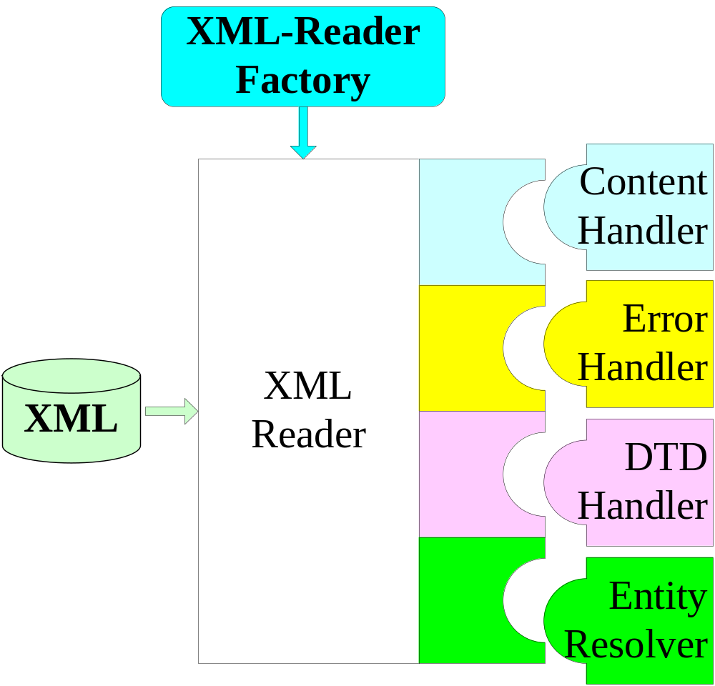
Used to create a SAX Parser
Handles document events: start tag, end tag, etc.
Handles Parser Errors
Handles DTD
Handles Entities

Slide 26
Creating a Parser
The SAX interface is an accepted standard
There are many implementations of many vendors
  Standard API does not include an actual implementation, but Sun provides one with JDK
Like to be able to change the implementation used without changing any code in the program
  How is this done?

Slide 27
Factory Design Pattern
Have a “factory” class that creates the actual parsers
  org.xml.sax.helpers.XMLReaderFactory
The factory checks configurations, such as the of a system property, that specify the implementation
  Can be set outside the Java code: a configuration file, a command-line argument, etc.
In order to change the implementation, simply change the system property

Slide 28
Creating a SAX Parser
import org.xml.sax.*;
import org.xml.sax.helpers.*;
public class EchoWithSax {
public static void main(String[] args) throws Exception {
System.setProperty("org.xml.sax.driver",
"org.apache.xerces.parsers.SAXParser");
XMLReader reader =
XMLReaderFactory.createXMLReader();
reader.parse("world.xml");
}
}

Slide 29
Implementing the Content Handler
A SAX parser invokes methods such as startDocument, startElement and endElement of its content handler as it runs
In order to react to parsing events we must:
  implement the ContentHandler interface
  set the parser’s content handler with an instance of our ContentHandler implementation

Slide 30
ContentHandler Methods
startDocument - parsing begins
endDocument - parsing ends
startElement - an opening tag is encountered
endElement - a closing tag is encountered
characters - text (CDATA) is encountered
ignorableWhitespace - white spaces that should be ignored (according to the DTD)
and more ...

Slide 31
The Default Handler
The class DefaultHandler implements all handler interfaces (usually, in an empty manner)
  i.e., ContentHandler, EntityResolver, DTDHandler, ErrorHandler
An easy way to implement the ContentHandler interface is to extend DefaultHandler

Slide 32
A Content Handler Example
import org.xml.sax.helpers.DefaultHandler;
import org.xml.sax.*;
public class EchoHandler extends DefaultHandler {
int depth = 0;
public void print(String line) {
for(int i=0; i<depth; ++i) System.out.print(" ");
System.out.println(line);
}

Slide 33
A Content Handler Example
public void startDocument() throws SAXException {
print("BEGIN"); }
public void endDocument() throws SAXException {
print("END"); }
public void startElement(String ns, String lName,
String qName, Attributes attrs) throws SAXException {
print("Element " + qName + "{");
++depth;
for (int i = 0; i < attrs.getLength(); ++i)
print(attrs.getLocalName(i) + "=" + attrs.getValue(i)); }

Slide 34
A Content Handler Example
public void endElement(String ns, String lName,
String qName) throws SAXException {
--depth;
print("}"); }
public void characters(char buf[], int offset, int len)
throws SAXException {
String s = new String(buf, offset, len).trim();
++depth; print(s); --depth; } }

Slide 35
Fixing The Parser
public class EchoWithSax {
public static void main(String[] args) throws Exception {
XMLReader reader =
XMLReaderFactory.createXMLReader();
reader.setContentHandler(new EchoHandler());
reader.parse("world.xml");
}
}

Slide 36
Empty Elements
What do you think happens when the parser parses an empty element?
<rating stars="five" />

Slide 37
Attributes Interface
The Attributes interface provides an access to all attributes of an element
  getLength(), getQName(i), getValue(i), getType(i), getValue(qname), etc.
The following are possible types for attributes:
  CDATA, ID, IDREF, IDREFS, NMTOKEN, NMTOKENS, ENTITY, ENTITIES, NOTATION
There is no distinction between attributes that are defined explicitly from those that are specified in the DTD (with a default value)

Slide 38
ErrorHandler Interface
We implement ErrorHandler to receive error events (similar to implementing ContentHandler)
DefaultHandler implements ErrorHandler in an empty fashion, so we can extend it (as before)
An ErrorHandler is registered with
  reader.setErrorHandler(handler);
Three methods:
  void error(SAXParseException ex);
  void fatalError(SAXParserExcpetion ex);
  void warning(SAXParserException ex);

Slide 39
Parsing Errors
Fatal errors disable the parser from continuing parsing
  For example, the document is not well formed, an unknown XML version is declared, etc.
Errors occur the parser is validating and validity constrains are violated
Warnings occur when abnormal (yet legal) conditions are encountered
  For example, an entity is declared twice in the DTD

Slide 40
EntityResolver and DTDHandler
The class EntityResolver enables the programmer to specify a new source for translation of external entities
The class DTDHandler enables the programmer to react to notations and unparsed entities declarations inside the DTD

Slide 41
Features and Properties
SAX parsers can be configured by setting their features and properties
Syntax:
  reader.setFeature("feature-url", boolean)
  reader.setProperty("property-url", Object)
Standard feature URLs have the form:
  http://xml.org/sax/features/feature-name
Standard property URLs have the form
  http://xml.org/sax/properties/prop-name

Slide 42
Feature/Property Examples
Features:
  namespaces - are namespaces supported?
  validation - does the parser validate (against the declared DTD) ?
  http://apache.org/xml/features/nonvalidating/load-external-dtd
    Ignore the DTD? (spec. to Xerces implementation)
Properties:
  xml-string - the actual text that cased the current event (read-only)
  lexical-handler - see the next slide...

Slide 43
Lexical Events
Lexical events have to do with the way that a document was written and not with its content
Examples:
  A comment is a lexical event (<!-- comment -->)
  The use of an entity is a lexical event (&gt;)
These can be dealt with by implementing the LexicalHandler interface, and setting the lexical-handler property to an instance of the handler

Slide 44
LexicalHandler Methods
comment(char[] ch, int start, int length)
startCDATA()
endCDATA()
startEntity(java.lang.String name)
endEntity(java.lang.String name)
and more...

Slide 45
DOM – Document Object Model

Slide 46
DOM Parser
DOM = Document Object Model
Parser creates a tree object out of the document
User accesses data by traversing the tree
  The tree and its traversal conform to a W3C standard
The API allows for constructing, accessing and manipulating the structure and content of XML documents

Slide 47
<?xml version="1.0"?>
<!DOCTYPE countries SYSTEM "world.dtd">
<countries>
<country continent="&as;">
<name>Israel</name>
<population year="2001">6,199,008</population>
<city capital="yes"><name>Jerulsalem</name></city>
<city><name>Ashdod</name></city>
</country>
<country continent="&eu;">
<name>France</name>
<population year="2004">60,424,213</population>
</country>
</countries>

Slide 48
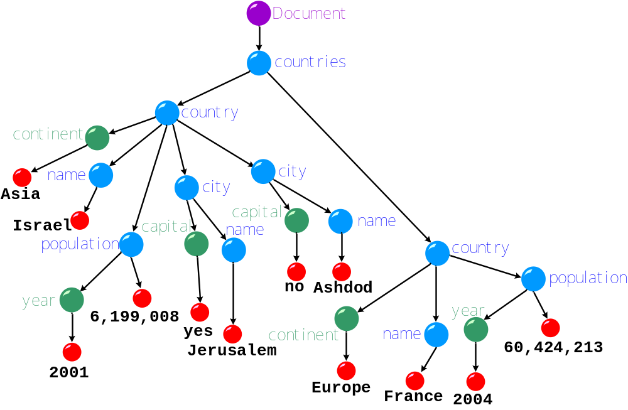
The DOM Tree

Slide 49

Using a DOM Tree
API
Application
XML File
DOM Parser
DOM Tree

Slide 50
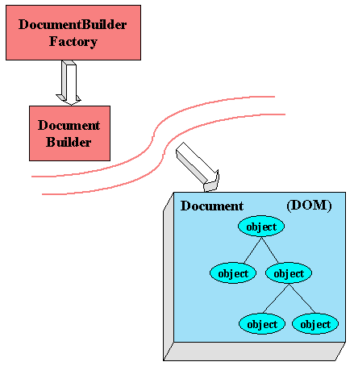

Slide 51
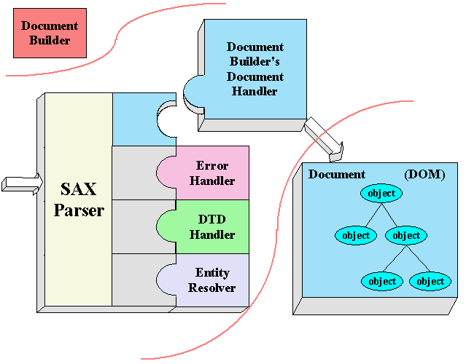

Slide 52
Creating a DOM Tree
A DOM tree is generated by a DocumentBuilder
The builder is generated by a factory, in order to be implementation independent
The factory is chosen according to the system configuration
DocumentBuilderFactory factory =
DocumentBuilderFactory.newInstance();
DocumentBuilder builder = factory.newDocumentBuilder();
Document doc = builder.parse("world.xml");

Slide 53
Configuring the Factory
The methods of the document-builder factory enable you to configure the properties of the document building
For example
  factory.setIgnoringElementContentWhitespace(true);
  factory.setValidating(true)
  factory.setIgnoringComments(false)

Slide 54
The Node Interface
The nodes of the DOM tree include
  a special root (denoted document)
  element nodes
  text nodes and CDATA sections
  attributes
  comments
  and more ...
Every node in the DOM tree implements the Node interface

Slide 55
Node Navigation
Every node has a specific location in tree
Node interface specifies methods for tree navigation
  Node getFirstChild();
  Node getLastChild();
  Node getNextSibling();
  Node getPreviousSibling();
  Node getParentNode();
  NodeList getChildNodes();
  NamedNodeMap getAttributes()

Slide 56
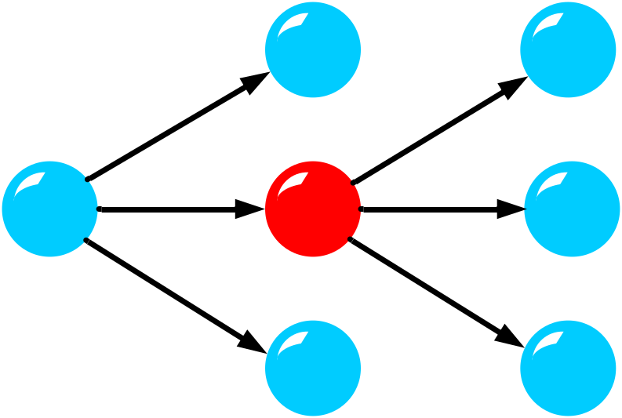
Node Navigation (cont)
getPreviousSibling()
getFirstChild()
getParentNode()
getChildNodes()
getLastChild()
getNextSibling()

Slide 57
Node Properties
Every node has
  a type
  a name
  a value
  attributes
The roles of these properties differ according to the node types
Nodes of different types implement different interfaces (that extend Node)

Slide 58
Interfaces in a DOM Tree
Figure as appears in : “The XML Companion” - Neil Bradley
DocumentFragment
Document
Text
CDATASection
CharacterData
Comment
Attr
Element
Node
DocumentType
NodeList
Notation
Entity
NamedNodeMap
EntityReference
ProcessingInstruction
DocumentType

Slide 59
Interfaces in the DOM Tree
Document
Document Type
Element
Attribute
Attribute
Element
Element
Text
Text
Element
Entity Reference
Text
Text
Comment
Text

Slide 60
Names, Values and Attributes
Interface | nodeName | nodeValue | attributes
Attr | name of attribute | value of attribute | null
CDATASection | "#cdata-section" | content of the Section | null
Comment | "#comment" | content of the comment | null
Document | "#document" | null | null
DocumentFragment | "#document-fragment" | null | null
DocumentType | doc-type name | null | null
Element | tag name | null | NodeMap
Entity | entity name | null | null
EntityReference | name of entity referenced | null | null
Notation | notation name | null | null
ProcessingInstruction | target | entire content | null
Text | "#text" | content of the text node | null

Slide 61
Node Types - getNodeType()
ELEMENT_NODE = 1
ATTRIBUTE_NODE = 2
TEXT_NODE = 3
CDATA_SECTION_NODE = 4
ENTITY_REFERENCE_NODE = 5
ENTITY_NODE = 6
PROCESSING_INSTRUCTION_NODE = 7
COMMENT_NODE = 8
DOCUMENT_NODE = 9
DOCUMENT_TYPE_NODE = 10
DOCUMENT_FRAGMENT_NODE = 11
NOTATION_NODE = 12
if (myNode.getNodeType() == Node.ELEMENT_NODE) {
//process node
…
}

Slide 62
import org.w3c.dom.*;
import javax.xml.parsers.*;
public class EchoWithDom {
public static void main(String[] args) throws Exception {
DocumentBuilderFactory factory =
DocumentBuilderFactory.newInstance();
factory.setIgnoringElementContentWhitespace(true);
DocumentBuilder builder = factory.newDocumentBuilder();
Document doc = builder.parse(“world.xml");
new EchoWithDom().echo(doc);
}

Slide 63
private void echo(Node n) {
print(n);
if (n.getNodeType() == Node.ELEMENT_NODE) {
NamedNodeMap atts = n.getAttributes();
++depth;
for (int i = 0; i < atts.getLength(); i++) echo(atts.item(i));
--depth; }
depth++;
for (Node child = n.getFirstChild(); child != null;
child = child.getNextSibling()) echo(child);
depth--;
}

Slide 64
private int depth = 0;
private String[] NODE_TYPES = {
"", "ELEMENT", "ATTRIBUTE", "TEXT", "CDATA",
"ENTITY_REF", "ENTITY", "PROCESSING_INST",
"COMMENT", "DOCUMENT", "DOCUMENT_TYPE",
"DOCUMENT_FRAG", "NOTATION" };
private void print(Node n) {
for (int i = 0; i < depth; i++) System.out.print(" ");
System.out.print(NODE_TYPES[n.getNodeType()] + ":");
System.out.print("Name: "+ n.getNodeName());
System.out.print(" Value: "+ n.getNodeValue()+"\n");
}}

Slide 65
Another Example
public class WorldParser {
public static void main(String[] args) throws Exception {
DocumentBuilderFactory factory =
DocumentBuilderFactory.newInstance();
factory.setIgnoringElementContentWhitespace(true);
DocumentBuilder builder =
factory.newDocumentBuilder();
Document doc = builder.parse("world.xml");
printCities(doc);
}

Slide 66
Another Example (cont)
public static void printCities(Document doc) {
NodeList cities = doc.getElementsByTagName("city");
for(int i=0; i<cities.getLength(); ++i) {
printCity((Element)cities.item(i));
}
}
public static void printCity(Element city) {
Node nameNode =
city.getElementsByTagName("name").item(0);
String cName = nameNode.getFirstChild().getNodeValue();
System.out.println("Found City: " + cName);
}

Slide 67
Normalizing the DOM Tree
Normalizing a DOM Tree has two effects:
  Combine adjacent textual nodes
  Eliminate empty textual nodes
To normalize, apply the normalize() method to the document element

Slide 68
Node Manipulation
Children of a node in a DOM tree can be manipulated - added, edited, deleted, moved, copied, etc.
To constructs new nodes, use the methods of Document
  createElement, createAttribute, createTextNode, createCDATASection etc.
To manipulate a node, use the methods of Node
  appendChild, insertBefore, removeChild, replaceChild, setNodeValue, cloneNode(boolean deep) etc.

Slide 69
Node Manipulation (cont)
Figure as appears in “The XML Companion” - Neil Bradley
Old
New
New
Ref
insertBefore
replaceChild
deep = 'false'
cloneNode
deep = 'true'

Slide 70
SAX vs. DOM

Slide 71
Parser Efficiency
The DOM object built by DOM parsers is usually complicated and requires more memory storage than the XML file itself
  A lot of time is spent on construction before use
  For some very large documents, this may be impractical
SAX parsers store only local information that is encountered during the serial traversal
Hence, programming with SAX parsers is, in general, more efficient

Slide 72
Programming using SAX is Difficult
In some cases, programming with SAX is difficult:
  How can we find, using a SAX parser, elements e1 with ancestor e2?
  How can we find, using a SAX parser, elements e1 that have a descendant element e2?
  How can we find the element e1 referenced by the IDREF attribute of e2?

Slide 73
Node Navigation
SAX parsers do not provide access to elements other than the one currently visited in the serial (DFS) traversal of the document
In particular,
  They do not read backwards
  They do not enable access to elements by ID or name
DOM parsers enable any traversal method
Hence, using DOM parsers is usually more comfortable

Slide 74
More DOM Advantages
DOM object ⇔ compiled XML
You can save time and effort if you send and receive DOM objects instead of XML files
  But, DOM object are generally larger than the source
DOM parsers provide a natural integration of XML reading and manipulating
  e.g., “cut and paste” of XML fragments

Slide 75
Which should we use?
DOM vs. SAX
If your document is very large and you only need a few elements – use SAX
If you need to manipulate (i.e., change) the XML – use DOM
If you need to access the XML many times – use DOM (assuming the file is not too large)

